Slide 1


Paper ID - 581
Paper Title
Leveraging Explainable Artificial Intelligence for Real-Time Diagnosis of Polycystic Ovary Syndrome: A Transparent Approach
Authors
Kanij Fatema Arpa, Md Tahsin, Maksura Binte Rabbani Nuha,
and *Ahmed Wasif Reza

Slide 2

Overview
01
05
Introduction
Dataset Information
02
06
Motivation
Training Parameters
03
07
Literature Review
Model Architecture & Results
04
08
Methodology
Conclusion & Future Works

Slide 3
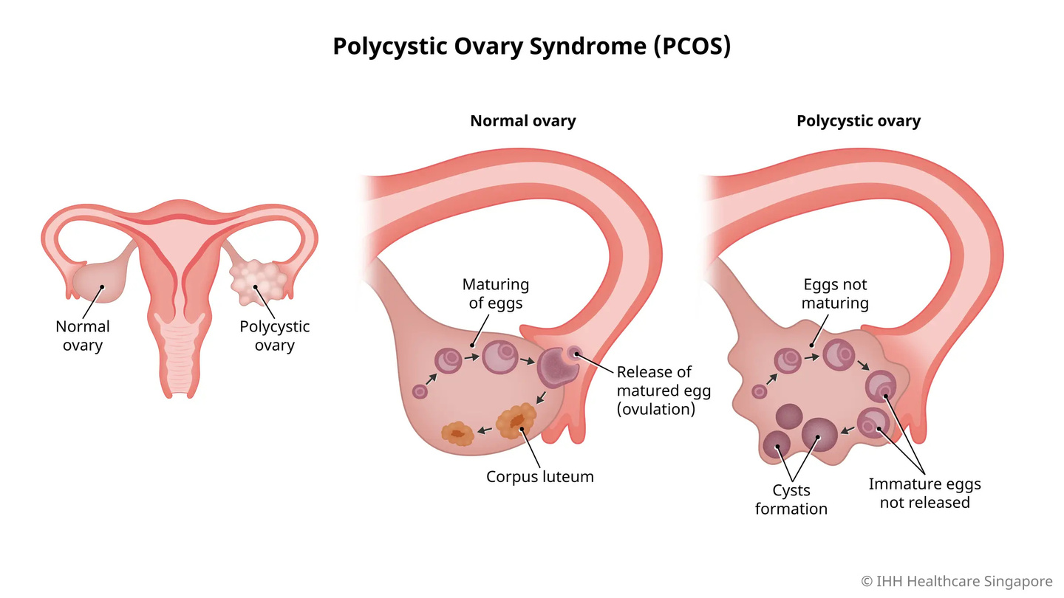
INTRODUCTION
PCOS severely impacts women’s health, causing infertility, diabetes, cancer risks, metabolic syndrome, obesity, depression, and glucose intolerance. Diagnosis follows Rotterdam Criteria: irregular periods, high male hormones, or ovarian cysts. Causes include genetics, obesity, and insulin resistance. AI improves diagnostic accuracy using DL and XAI, providing faster and reliable healthcare solutions with accurate ovaries classification as normal or affected. Our study, achieving 100% accuracy with DL models, leverages Explainable AI to provide reliable and accessible diagnoses for better healthcare outcomes.
Maturing Of
Eggs
Eggs Not Maturing
Ovulation
(Matured Egg release)
Corpus luteum
Cysts Formation
Immature eggs
Not released
Fig. 01: Healthy Ovary
Fig. 02: Polycystic ovary
01

Slide 4




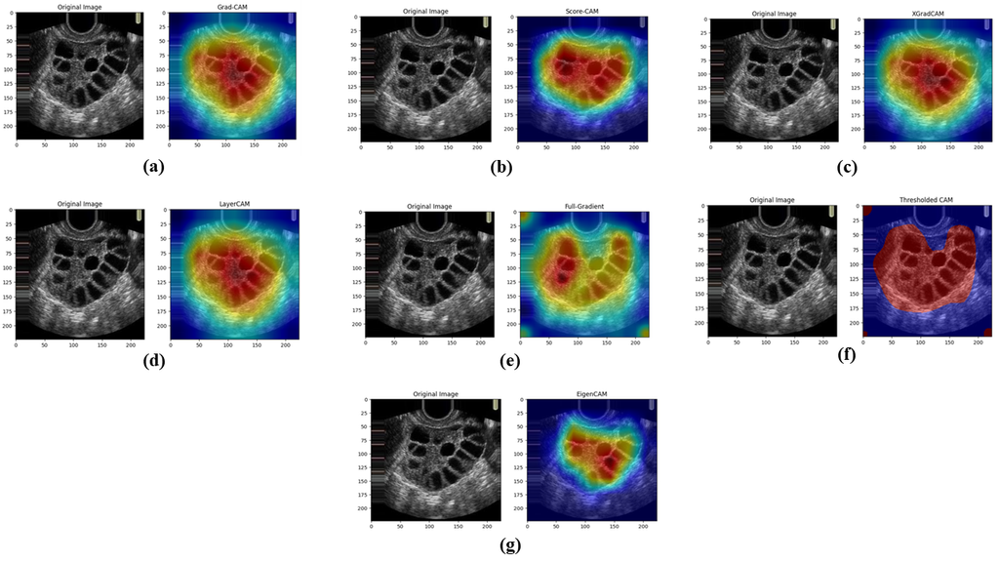


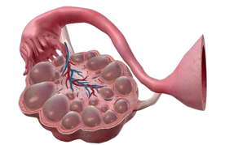


MOTIVATION
ultrasonography technological development
Traditional Limitations
Dataset Collection
Data Efficiency
Slow manual interpretation, limited generalizability, model complexity, and inconsistent preprocessing.
AI-powered diagnostic system : XAI & DL models (DenseNet201, InceptionV3, EfficientNetV2) .
Trained on 3,874 ultrasound images, Surpassed traditional methods achieving 100%.
Disease Impact
Severe
Health Risks
Addressing Healthcare Gaps
Ethical
Impact
Affects 5-15% of females globally, the most common hormonal disorder in reproductive-age women.
Causes infertility, diabetes, depression, and higher cardiovascular risk.
Existing PCOS methods lack data and interpretability; AI ensures accessible, reliable diagnoses.
XAI ensures ethical, transparent AI decisions, with a real-time web deployment in clinics and remote care.
02

Slide 5
LITERATURE REVIEW
Cite | Method | Model | Dataset | Result | Limitations
[3]
[12]
[19]
[14]
[18]
Stacking ensemble ML; CNN for feature extraction; integrated "VggNet16" with meta-learner "XGBoost".
594 USG images (PCOS and non-PCOS classes)
Complex model; lacks interpretability, viewed as a "black box" by physicians.
Ensemble Stacked Model
(CNN + XGBoost)
99.89%
SMOTE + ENN for class balancing; RFE for feature selection; meta-learner with ensemble ML models.
Kaggle dataset;
541 patient records
364 healthy, 177 PCOS
Highly complex; challenges in real-world applicability despite 100% accuracy.
Ensemble Stacked Model
100%
Multi-level stacked ensemble learning; evaluated clinical, physical, and biochemical parameters.
Kaggle dataset;
541 patient records
364 healthy, 177 PCOS.
Lack of standardized diagnostic criteria; limited real-world validation of clinical outcomes.
Ensemble Stacked Model
98%
K-means clustering for follicle detection.
Small dataset; high false rejection rate; requires improvement in segmentation reliability.
K-means Clustering
19 USG images from two diagnostic centers.
84.61%
Random Forest (RF) and AdaBoost (AB); used Mutual Information for feature selection.
Kaggle dataset;
541 patient records
(43 attributes included).
RF + AB
Accuracy limited to 94%; lacks real-time implementation or explainability.
94%

Slide 6
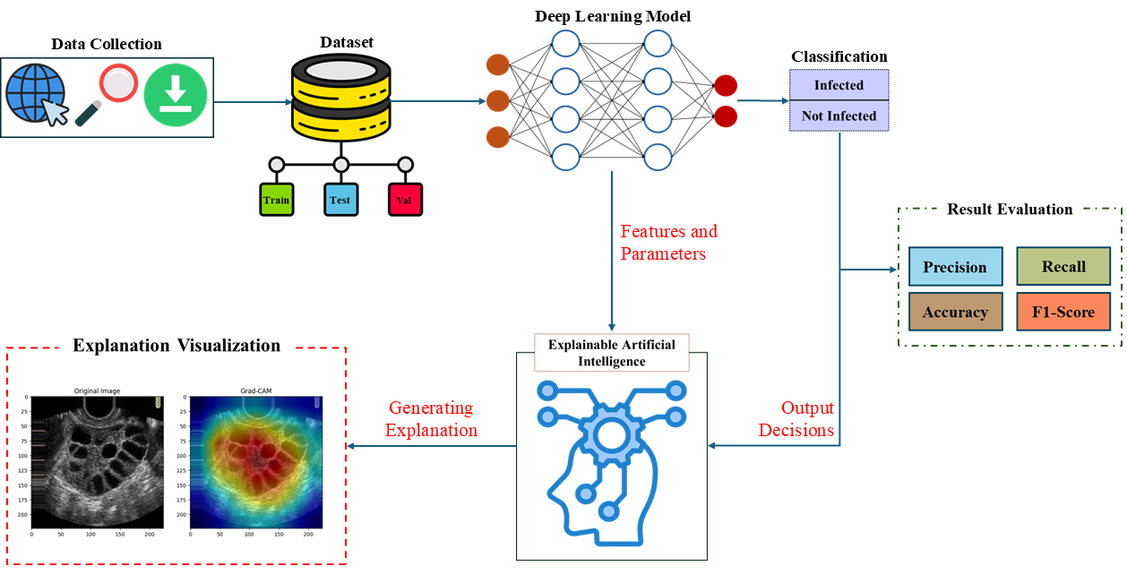
METHODOLOGY
03

Slide 7
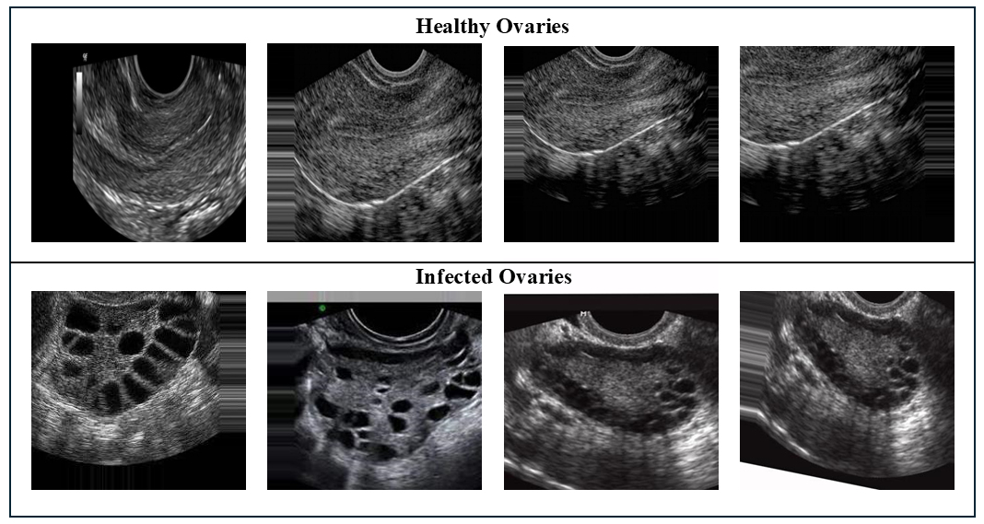
DATASET INFORMATIONS
This study used the Kaggle dataset "PCOS Detection Using Ultrasound Images," containing 3,874 images: 1,586 infected (PCOS) and 2,288 healthy ovaries. These JPG ultrasound images capture features like cyst count, size, ovarian volume, and endometrial thickness.
04

Slide 8
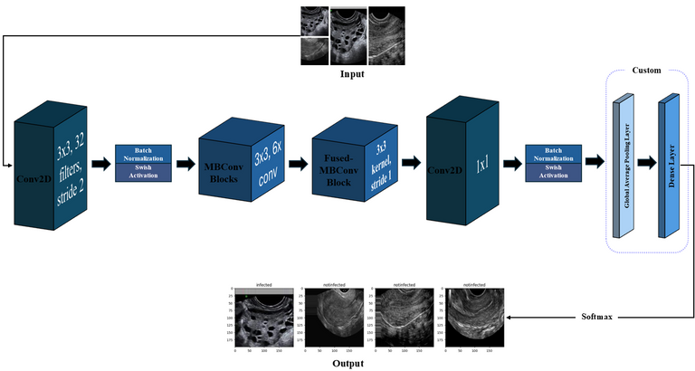
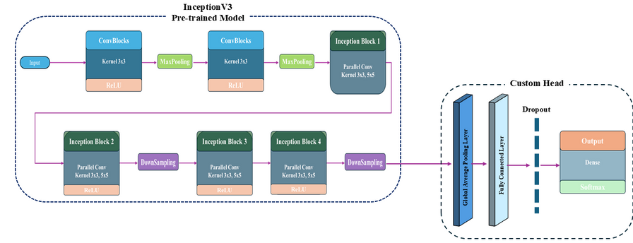
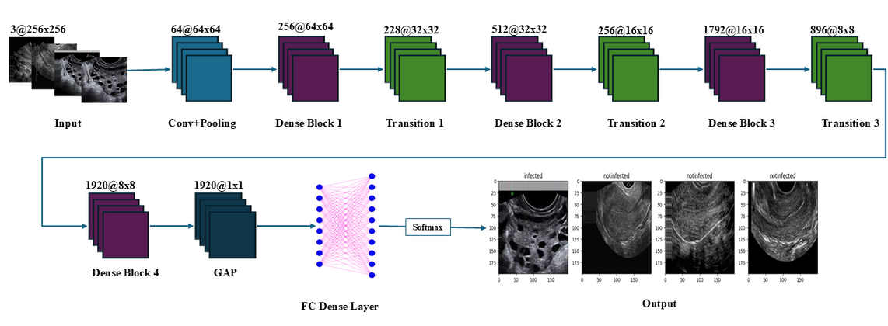
APPLIED MODEL FRAMEWORK
Figure 01: Illustration of EfficientNetV2 model
Figure 02: Diagram of InceptionV3 Model
Figure 03: Architecture of DenseNet201 model
05

Slide 9
EXPERIMENTAL SETUP TABLES
Hyperparameter | Value
Epochs | 25
Batch Size | 10
Input Image Resolution | 256x256
Data Splitting Ratio | 80:10:10
Optimizer | ADAM
Dropout | 60%
Patience Score | 5
Learning Rate | 0.0009
Loss Function | Categorical Cross-Entropy Loss
06

Slide 10
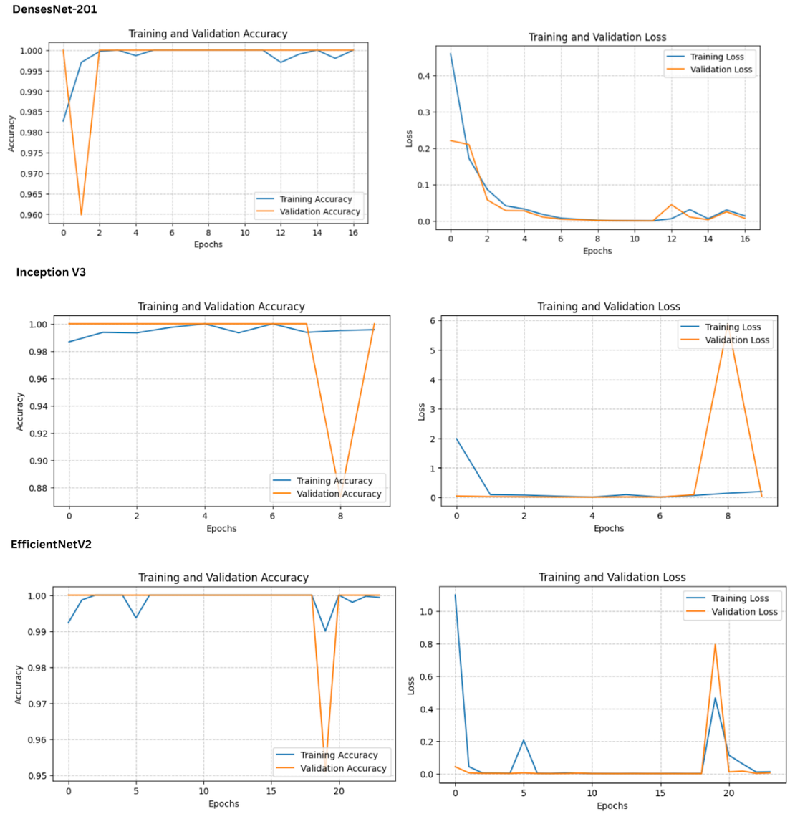
RESULT ANALYSIS
DenseNet201
EfficientNetV2
InceptionV3
Figure 04: Training & Validation accuracy & loss of Supervised Models
The top-performing models, DenseNet201, InceptionV3, and EfficientNetV2, achieved perfect scores (100% accuracy, precision, recall, and F1-score) on PCOS classification, with DenseNet201 showing the most stable performance.
07

Slide 11
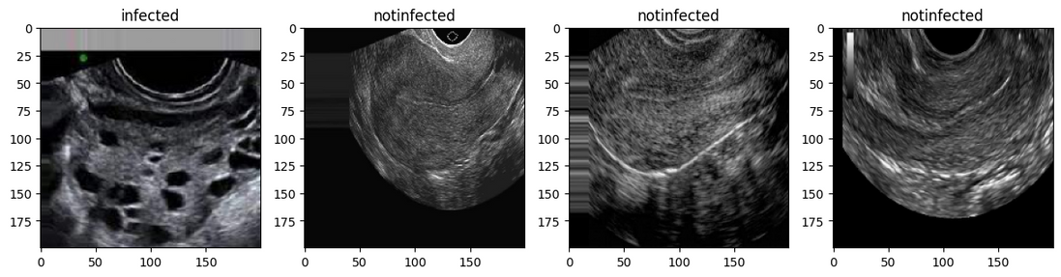
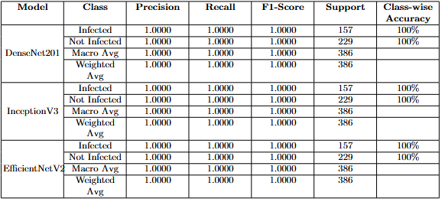
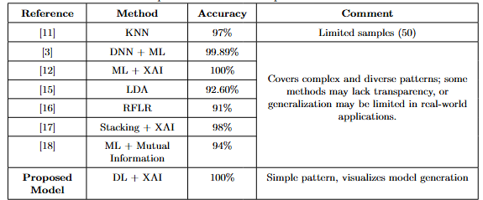
DISCUSSION
Figure 05:Obtained Results of USG Images.
B. Rachana
S. A. Suha
H. Elmannai
A. Mandal
S. Bharati
V. Khanna
M. Rahman
Proposed Model
Table 02: Obtained Experimental Results.
Table 03: Experimental Result Comparison.
08

Slide 12
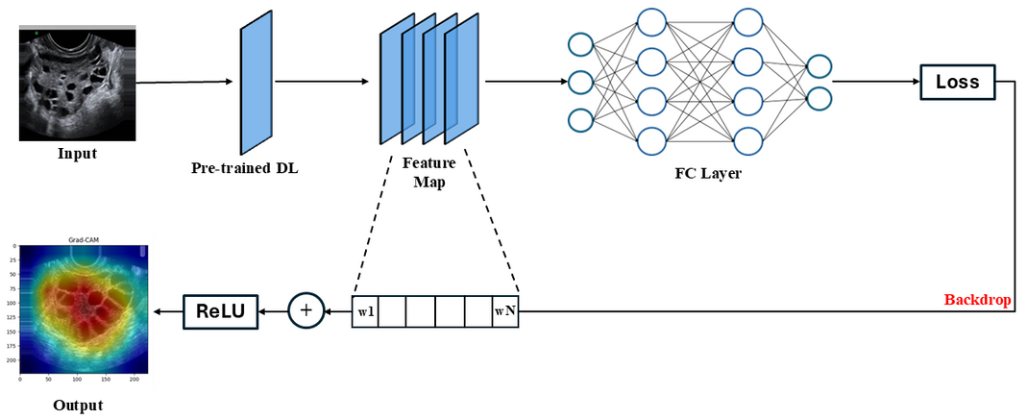

EXPLAINABLE AI (XAI)
Figure 06: Explainable AI(XAI) Architecture
Figure 07: Different Explainable AI(XAI) Example
09

Slide 13
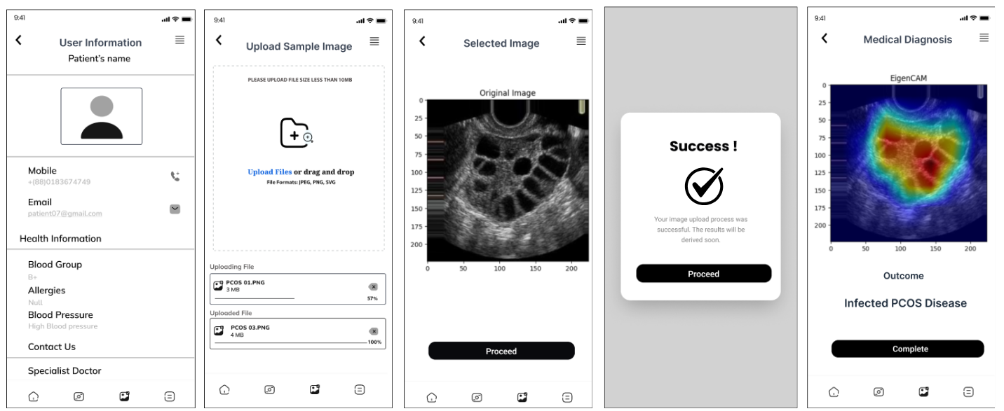
REAL-TIME WEB INTEGRATION USING XAI
Figure 08: UI of the proposed web application
The application uses a React-based frontend for user input and image upload, supporting formats like JPG and PNG. The backend, built with Flask, processes images, generates results, and visualizes defective areas using EigenCam.
10

Slide 14
CONCLUSION
This study introduces a DL-based method for diagnosing PCOS from ovarian ultrasound images using DenseNet201, InceptionV3, and EfficientNetV2, achieving perfect classification metrics, coupled with XAI heatmaps for transparent decision-making, this approach holds great promise for enhancing medical diagnoses.
High Accuracy
Explainability
Real-Time Implementation
Enhanced Physician Confidence
Scalable Framework
Achieved 100% accuracy, ensuring reliable PCOS diagnosis.
XAI heatmaps offer visual explanations, transparency boosting and trust in AI
Real-time diagnosis & Designed for clinical use with clear identification
Autonomous, measurable disease management approach.
Adaptable for robust future advancements and larger datasets.
11

Slide 15




01
Broaden Dataset Coverage
Expanding the dataset with more diverse and larger image collections to improve model generalization.
Generative AI & Self-Supervised Learning
02
Integrating Generative AI and Self-Supervised Learning for improved feature extraction and model performance.
FUTURE
WORKS
03
Edge AI Integration & Hybrid Model Implementation
Exploring the integration of Edge AI and hybrid model combinations for faster, on-site processing in clinical settings.
04
Real-time Feedback Mechanism
Provide immediate feedback during diagnosis to assist healthcare providers in decision-making.
12

Slide 16
REFERENCES
‌[1] S. A. Suha and M. N. Islam, “An extended machine learning technique for poly-cystic ovary syndrome detection using ovary ultrasound image,” Scientific Reports, vol. 12, no. 1, pp. 1–16, Oct. 2022, doi: 10.1038/s41598-022-21724-0.
‌[2] H. Elmannai et al., “Polycystic Ovary Syndrome Detection Machine Learning Model Based on Optimized Feature Selection and Explainable Artificial Intelligence,” Diagnostics, vol. 13, no. 8, Apr. 2023, doi: 10.3390/DIAGNOSTICS13081506.
‌[3] J. Deng, W. Dong, R. Socher, L. J. Li, K. Li, and L. Fei-Fei, “Application of machine learning and artificial intelligence in the diagnosis and classification of polycystic ovarian syndrome: a systematic review,” Front Endocrinol (Lausanne), vol. 14, p. 1106625, Sep. 2023, doi: 10.3389/FENDO.2023.1106625/BIBTEX.
[4]A. Mandal, D. Saha, and M. Sarkar, “Follicle Segmentation Using K-Means Clustering from Ultrasound Image of Ovary,” Advances in Intelligent Systems and Com-
puting, vol. 1255, pp. 545–553, 2021, doi: 10.1007/978-981-15-7834-2 51.
‌[5] M. M. Rahman et al., “Empowering early detection: A web-based machine learning approach for PCOS prediction,” Inform Med Unlocked, vol. 47, p. 101500, Jan. 2024, doi: 10.1016/J.IMU.2024.101500.
13

Slide 17

Thank You

